Slide 1
Predicting Salaries of NBA Players
What Is Your Worth?
Contributors: Matthew Reyes, Ryan Kincheloe, Harman Malhi, Akhyar Zaman, Emma Ng, Stelios Kosmidis

Slide 2


Topic: Can We Accurately Predict a Player’s Future Salary?
Using Machine Learning, we aim to figure out whether we can create a model to predict a player’s salary based on their statistics. A model that could predict a player’s future salary could be interesting to show the relationship between performance and the resulting contracts.

Slide 3


Data and Data Delivery (ETL)
Data was sourced from nba_api, kaggle, and HoopsHype Salary database
Using SQL, we created a database to house the player statistics and salaries over past years.

Slide 4
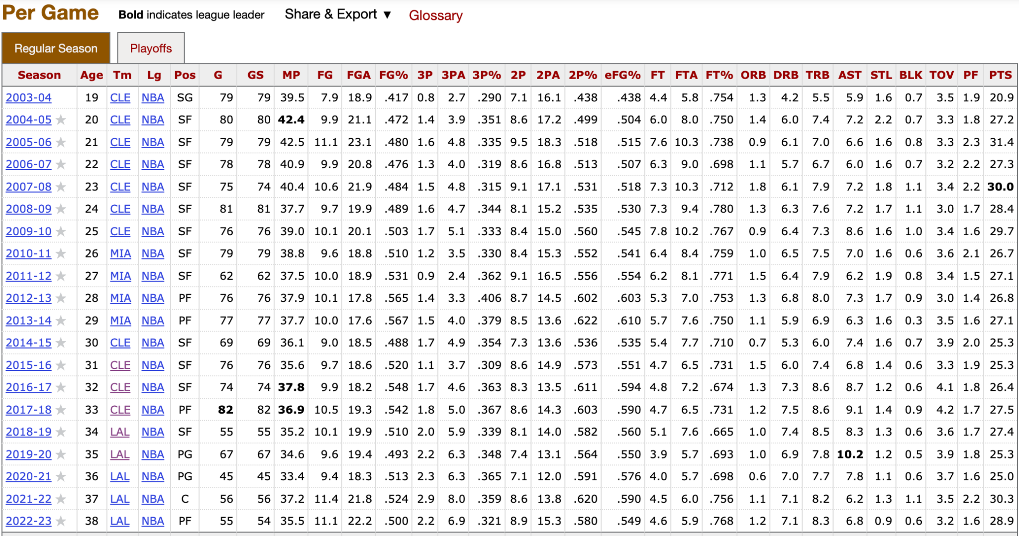
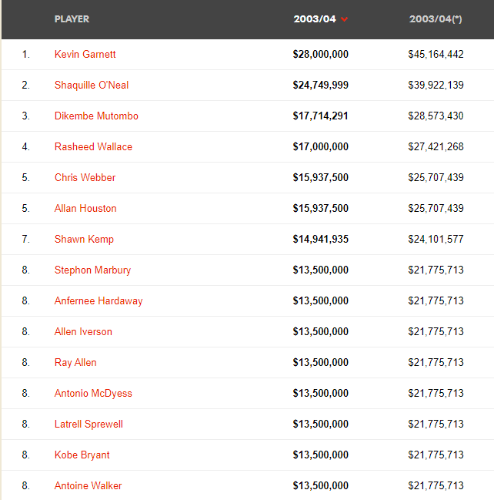
The Numbers
Notes:
Akhyar part:
Talk about basketball reference being one of our main sources for accurate data. Talk about how each statistic is important when it comes to player performance (briefly)
HoopsHype was one of the few sources that gave us contract summary from 2000.

Slide 5
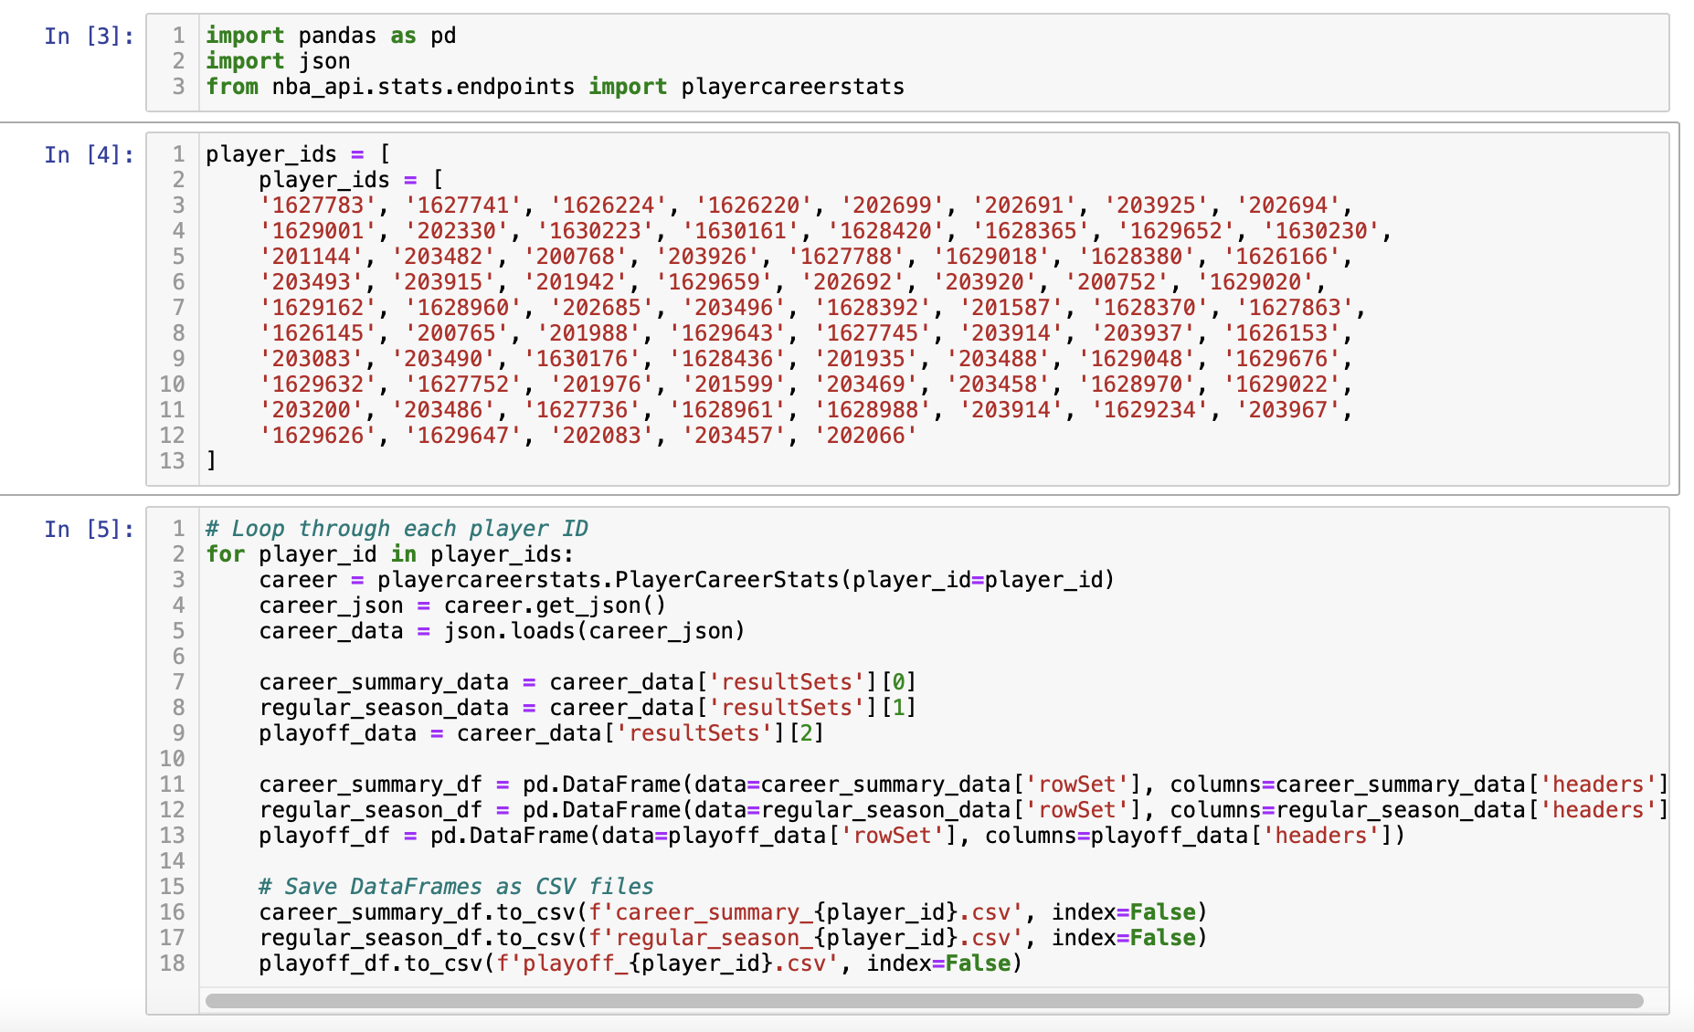
ETL Process
Notes:
Brief talk about the upcoming free agents
Mention how stats can be relevant and important when it comes to contract talks
Talk about the merging of the salary table with the statistics table

Slide 6
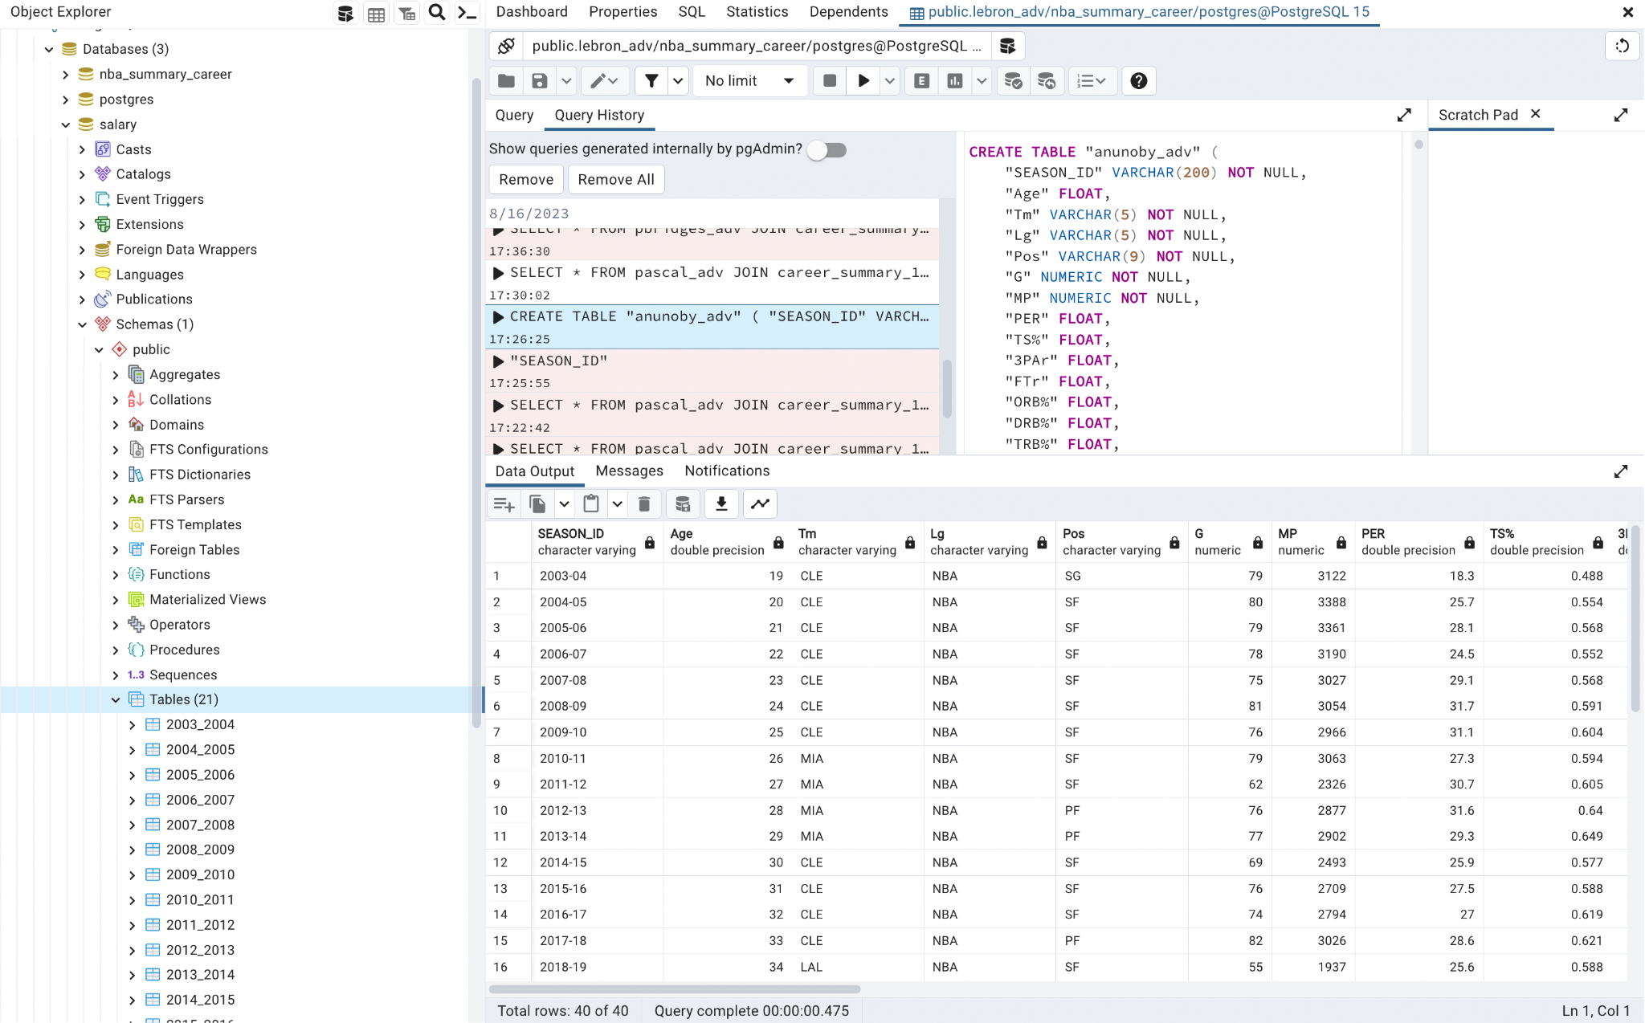
Notes:
Brief talk about the upcoming free agents
Mention how stats can be relevant and important when it comes to contract talks
Talk about the merging of the salary table with the statistics table

Slide 7
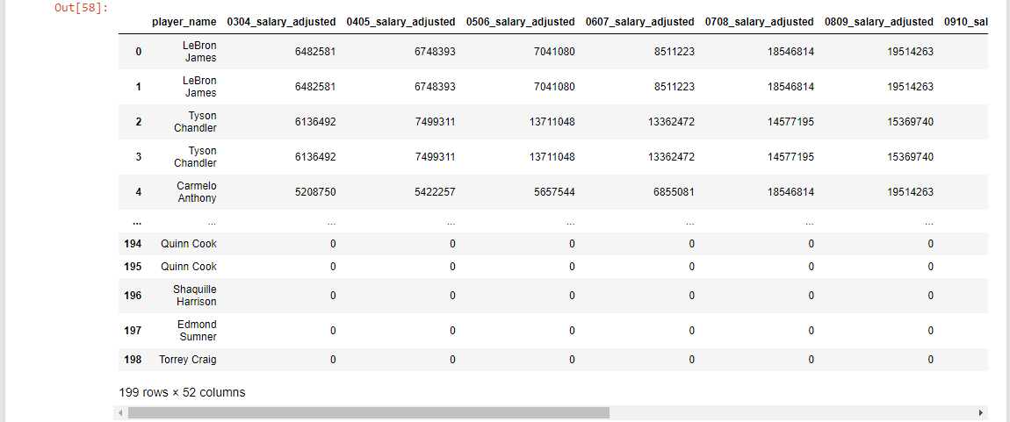
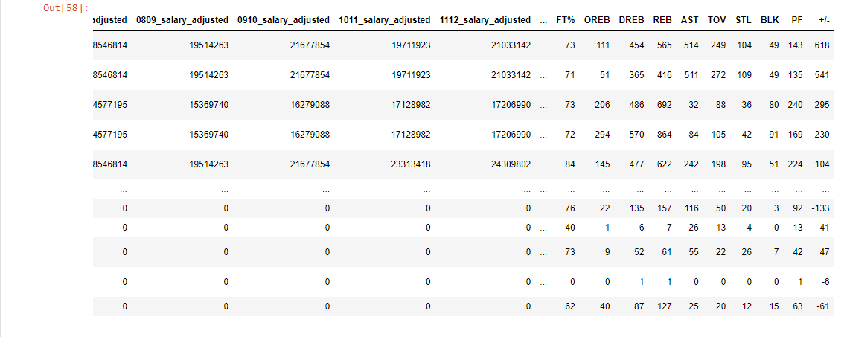

Slide 8
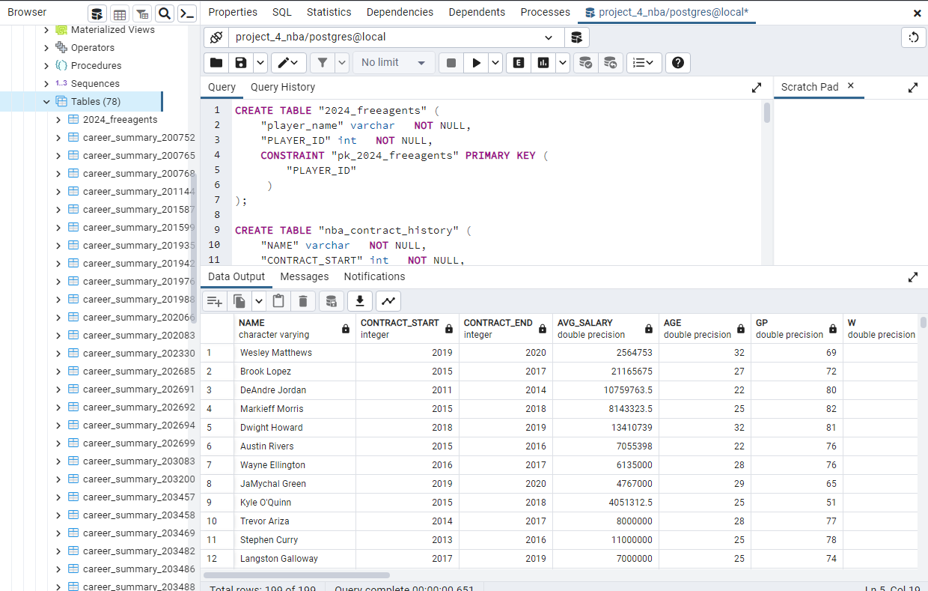
Notes:
Maybe delete this too

Slide 9
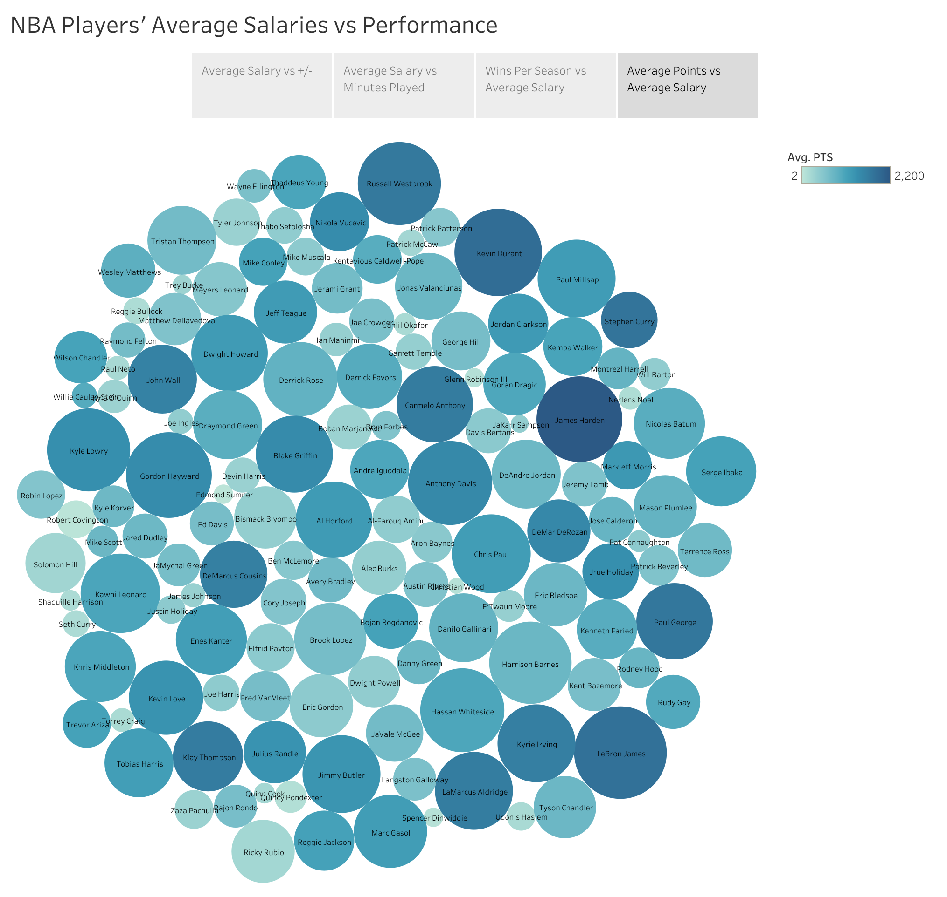
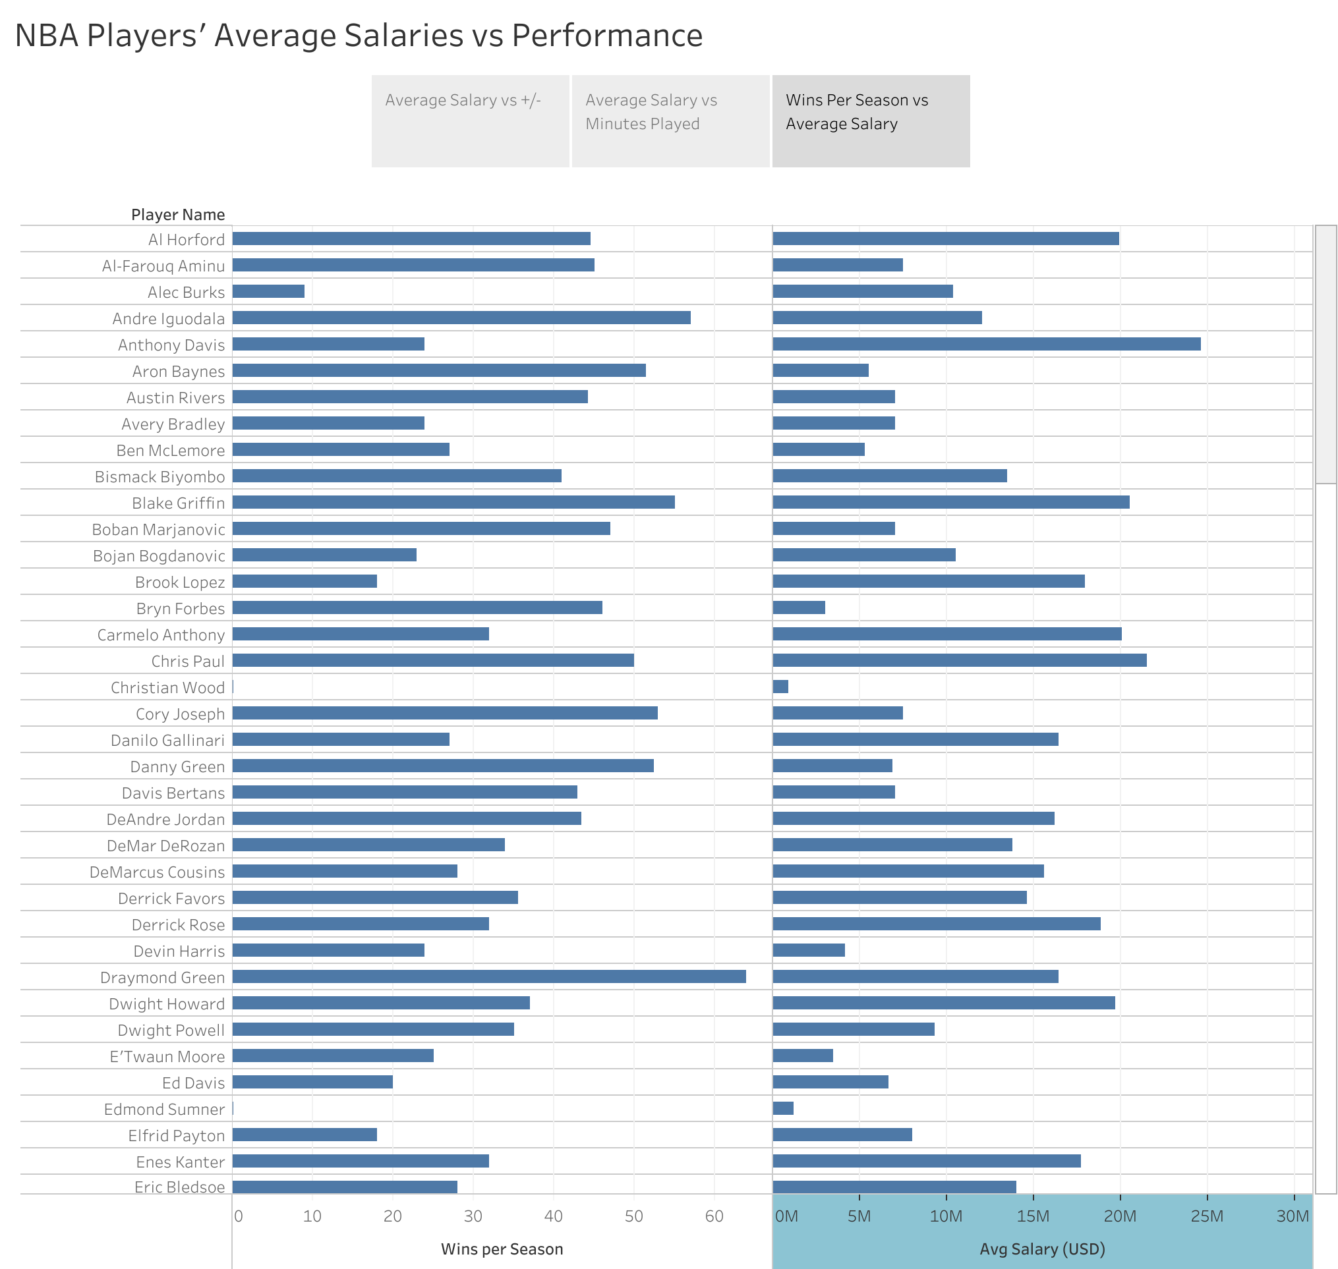
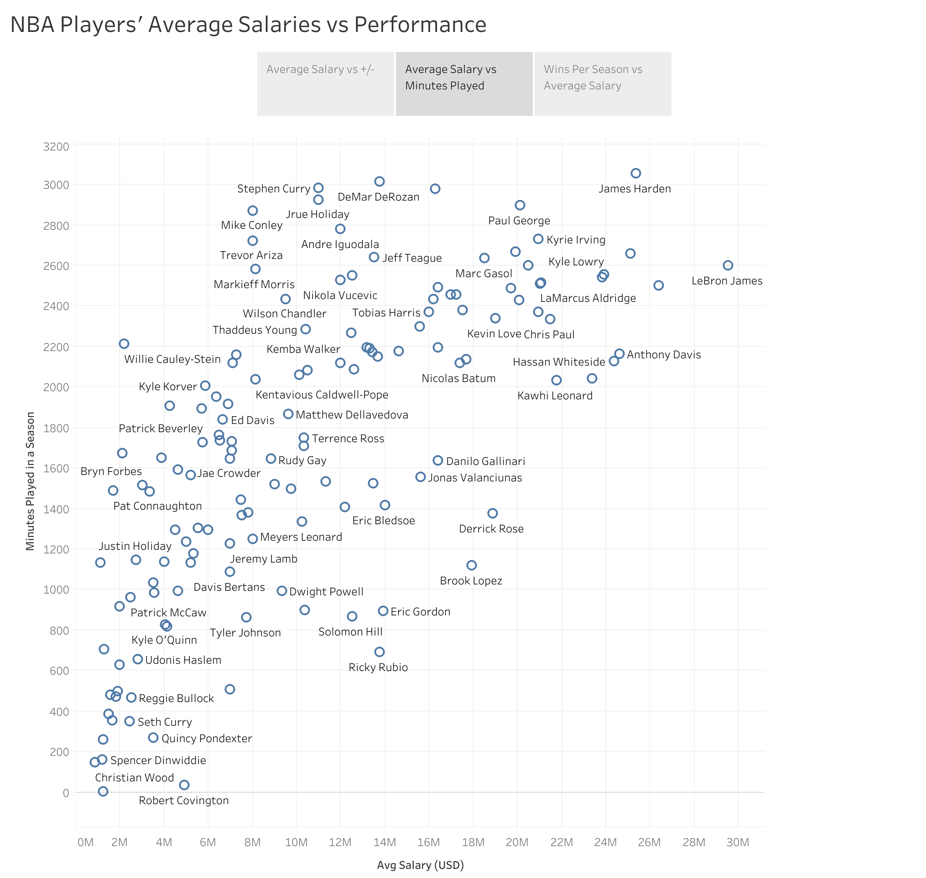
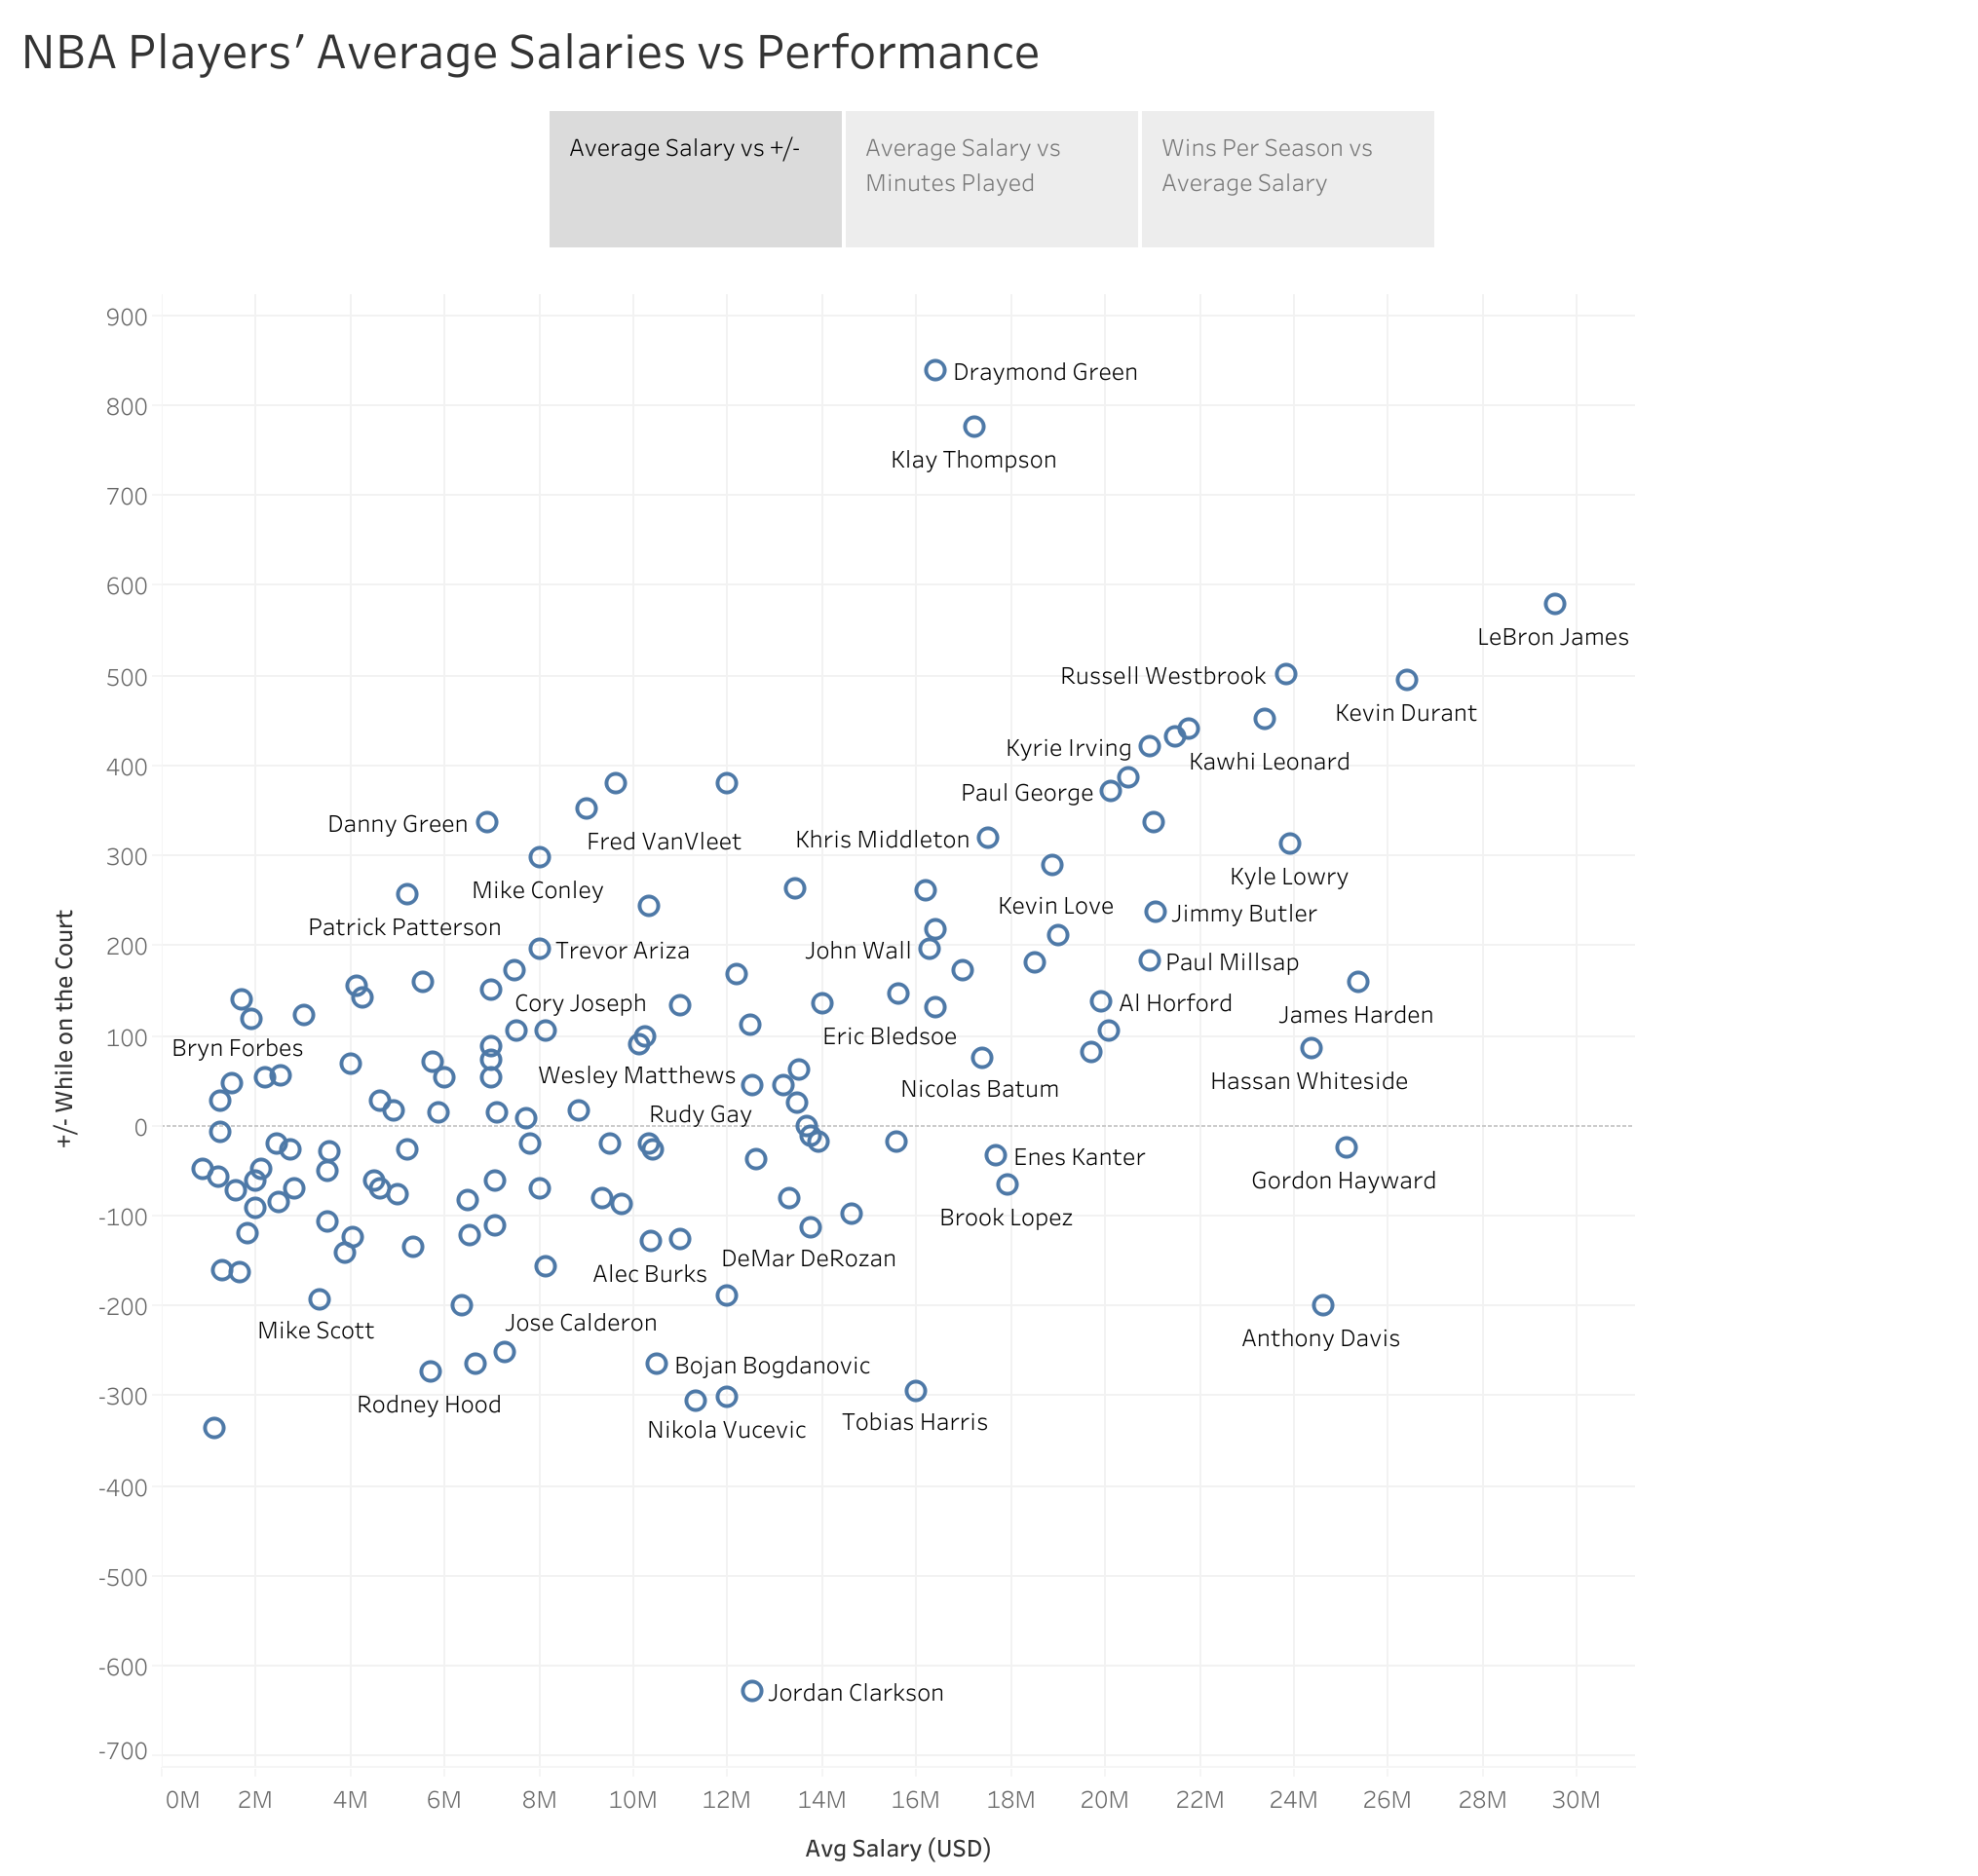
Visualizations
Using Tableau, we created some visualizations to graphically show the relationships between various factors and a player’s salary

Slide 10
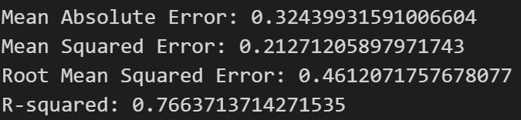
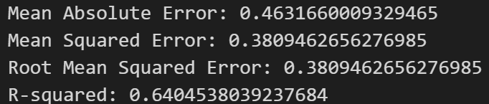
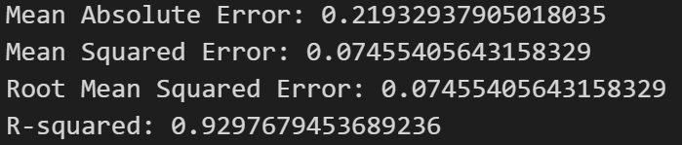
Machine Learning Model
Target: 2018-2019 salary
Utilized SKLearn linear regression and SDGRegressor
Optimization process
Re-processing the data!
Properly encoding categorical data
Model improves with each additional year
Model tuning
StandardScaler -> MinMaxScaler
Raise learning rate
Remove regularization
Target: 2019-2020 salary
Target: 2020-2021 salary

Slide 11
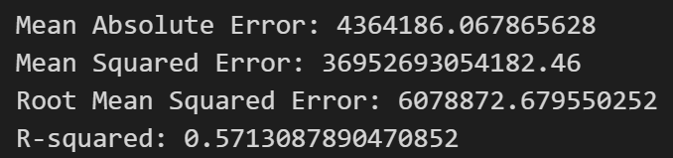
Machine Learning Model
Created and attempted to utilize a more comprehensive dataset with the following differences:
Columns for salary by year -> single salary column
1 player per row -> multiple rows for same player
Less historical salary data (earliest record 2003 -> 2010)
More comprehensive season statistical data (single season totals -> totals by season)
With more data came more challenges, and ultimately pushed us back to our original data set.
Target 2018-19 salary ->

Slide 12
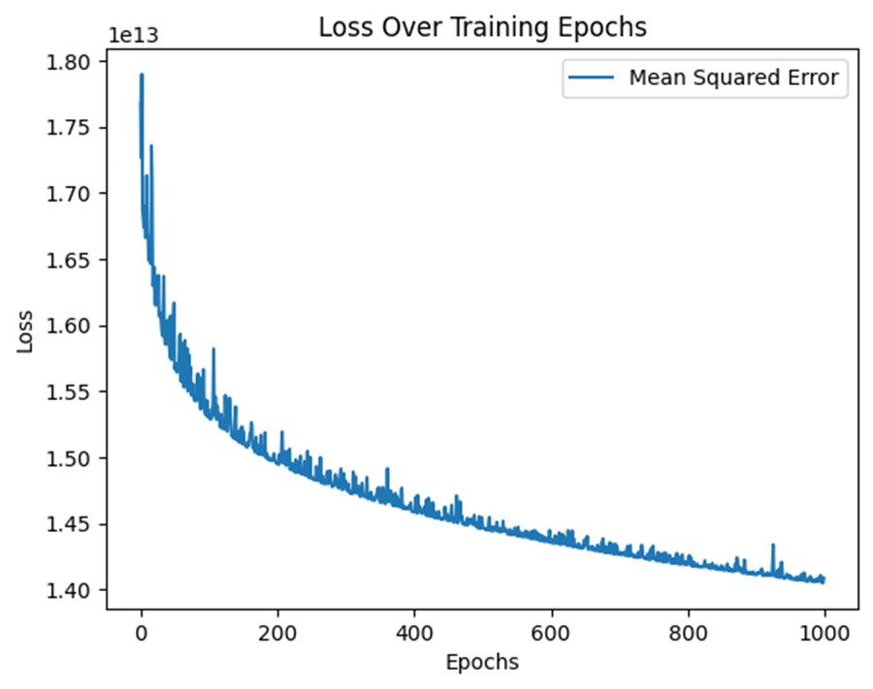
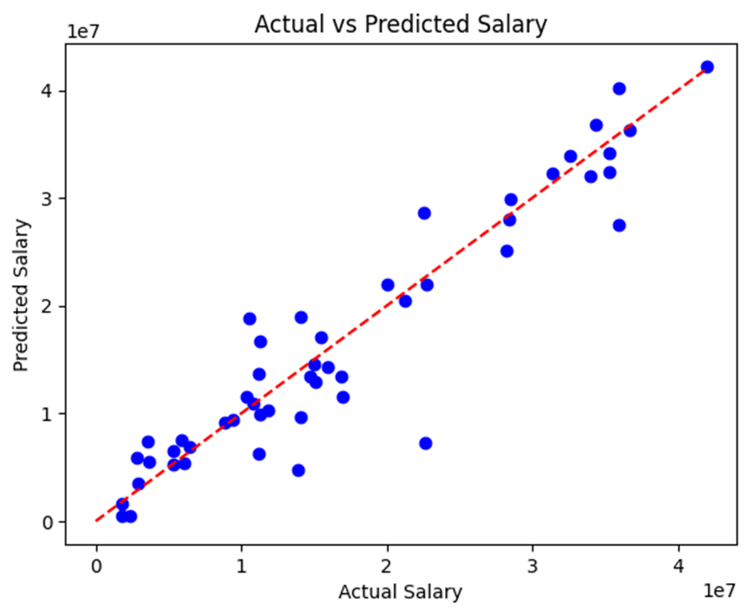
Machine Learning Model
Using the Stochastic Gradient Descent (SGD) as the optimization algorithm and calculated the MSE between actual and predicted salaries.
Scatter plot comparing the actual salaries against the predicted salaries using the model.
This approach simulates online learning, where the model is updated iteratively as new data becomes available.
The points represent the predicted salaries, and the red line represents ideal scenario where the actual and predicted salaries are the same.
Notes:
•SGDRegressor: This is a linear regression model from scikit-learn (sklearn) that uses Stochastic Gradient Descent (SGD) as the optimization algorithm.
•mean_squared_error: This function from sklearn.metrics calculates the mean squared error between the actual salary and the predicted salary. The alpha parameter is set to 0.01, which controls the regularization strength (L2 penalty)and the penalty parameter is set to None, indicating no regularization. Losses is created to store the mean squared error (MSE) values over training epochs and the variable num_epochs is set to 1000, representing the number of training iterations or epochs. This loop iterates over the specified number of epochs. In each epoch, the partial_fit method is called on the regression model, which updates the model's coefficients using a single batch of the training data. Then, predictions y_pred_train are made using the updated model, and the mean squared error (MSE) between the actual target values y_train and predictions is calculated. The calculated MSE is then added to the losses list. This loop iterates over a specified number of epochs (num_epochs) and performs partial fitting of the model using the X_train and y_train data. This approach simulates online learning, where the model is updated iteratively as new data becomes available. The graph shows helps visualize how the model's performance improves over time. The scatter plot comparing the actual salaries (y_test) against the predicted salaries (y_pred) using the trained model. The blue dots represent the predicted salaries, and the red dashed line represents the ideal scenario where actual and predicted salaries are the same.

Slide 13
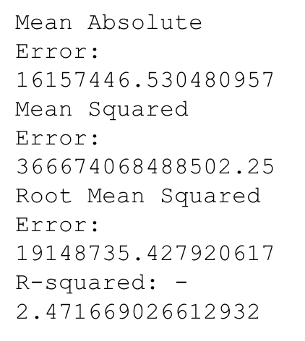
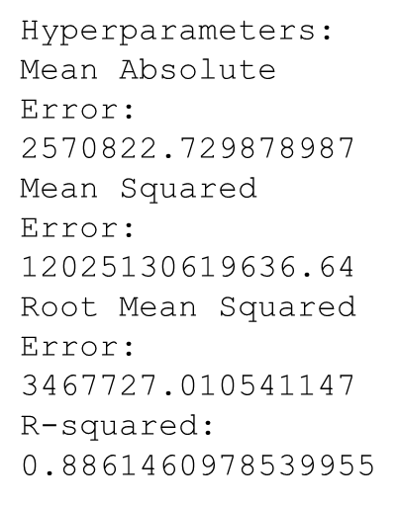
Machine Learning Model
We turned off the regularization while training in order to overcome the limited sample values. This might create overfitting of the data and limited generalization of the model.
Tensorflow neural network regression:
Hyperparamater tuning:
Notes:
To improve the performance of your model we perform hyperparameter tuning. This method uses a grid search approach. In this approach, you define a grid of hyperparameter values to search through and then evaluate the model's performance with each combination of hyperparameters. GridSearchCV .
We use a predefined grid of hyperparameters for the alpha (learning rate) and penalty (regularization) parameters. The scoring metric is set to negative mean squared error, which is common for regression problems. The grid search will perform cross-validation and evaluate the performance of the model with different combinations of hyperparameters. Once the grid search is complete, we extract the best hyperparameters and create a final model using those hyperparameters. Finally, we evaluate the final model's performance on the test set and print the results.

Slide 14
Challenges
Finding accurate data in a format we could work with
Limited data on certain players’ salaries/statistics over the years
Using a limited amount of variables to train the model
Data cleaning with large datasets

Slide 15
Future Plans and Next Steps
Expand the variables we used to train the model
Further optimize the model or create a newer/better one
Increase the sample size (i.e more players, more years)
Create an interactive website where users can input any statistics to predict future earnings of any player in the NBA

Slide 16
Questions?

